Slide 1

Sports Data Analytics: Basketball Analytics
Huijun Hong
CS 688
Final Project

Slide 2
Introduction
Sport Analytics
Apply Maths and Statistical to sports activities.
evaluating player performance
Basketball Analytics:
Data Collection
Assess player ability and potential by preprocess Data

Slide 3

Dataset
SportsAnalytics API for R (fetch_NBAPlayerStatistics)
NBA 07-08 Season
Philadelphia 76ers Team
Read Web HTML (read_html)
http://dougstats.com/07-08.html
5 teams for the 2007-2008 season that have the most wins
https://www.landofbasketball.com/world_cup_stats/medals_by_year.htm
display the location on the world map all of the Basketball World Cup Champion countries

Slide 4
Questions and Charts
Which player has the best three point percentage? Line Chart
Which player has played the largest number of minutes? Bar Chart
Which player has the most "Steals"? Column Chart
Which player has most Points/Free points Per Game? Area Chart
Which player has most Rebounds and Assists? Pie Chart
5 teams for the 2007-2008 season that have the most wins. Table Chart
Display the location on the world map all of the Basketball World Cup Champion countries. Geo Chart
Who is Team Most Valuable Player(MVP) in Philadelphia 76ers?

Slide 5
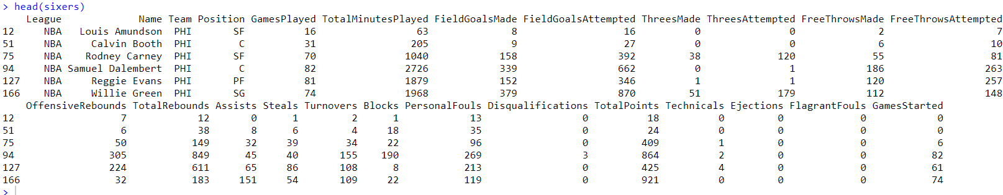
Team Data

Slide 6

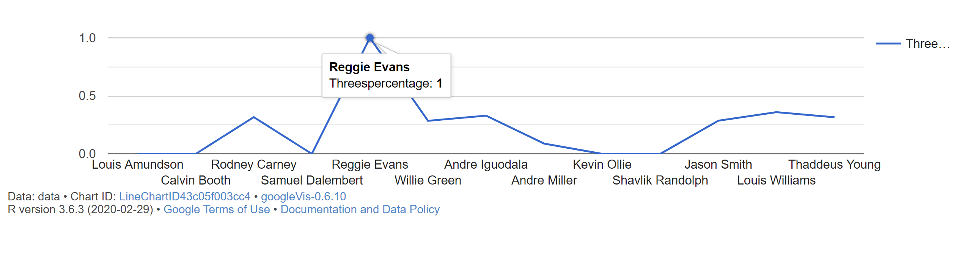
Line Chart
Which player has the best three point percentage?

Slide 7
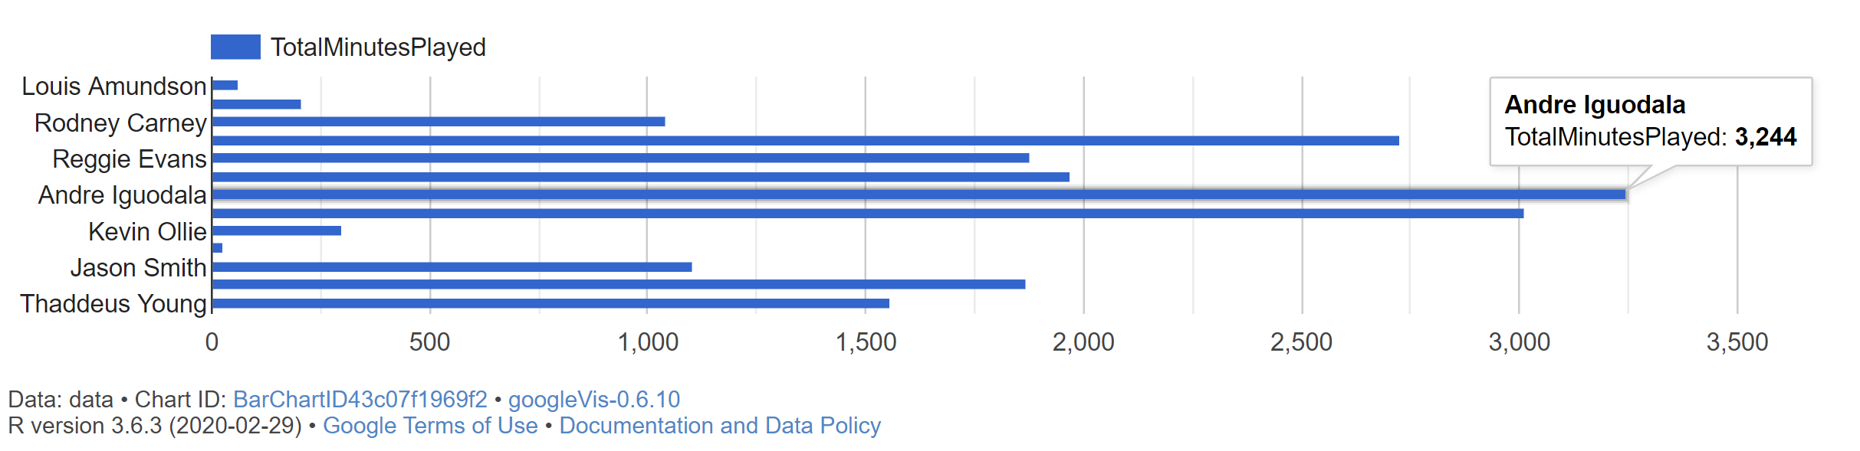
Bar Chart
Which player has played the largest number of minutes?

Slide 8
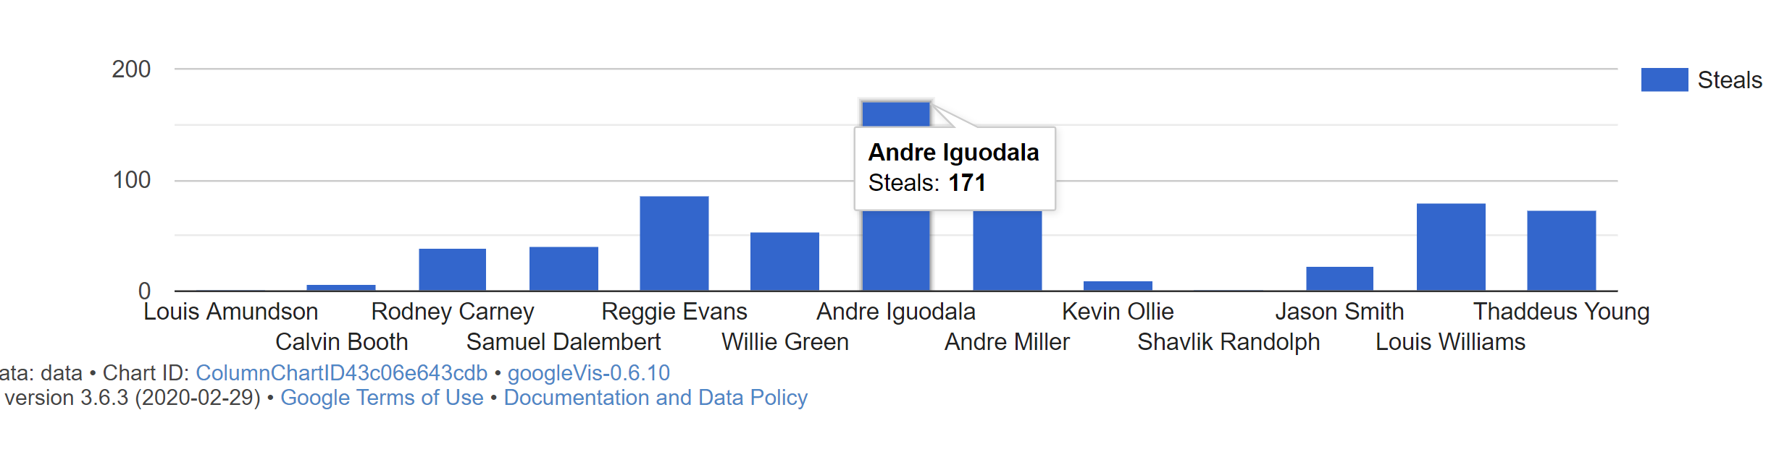
Column Chart
Which player has the most "Steals"?

Slide 9
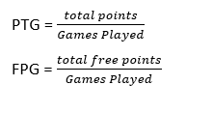
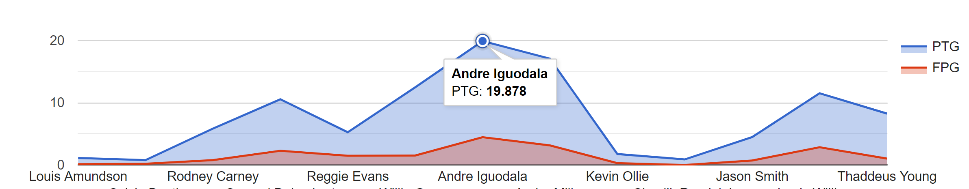
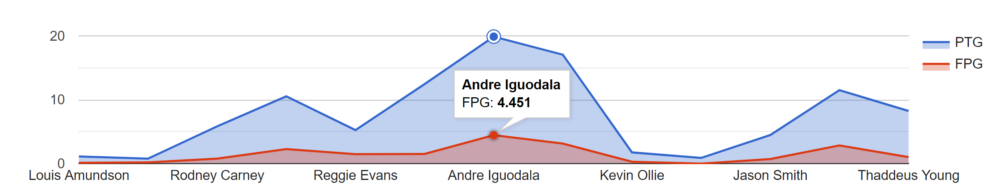
Area Chart
Which player has most Points/Free points Per Game?

Slide 10
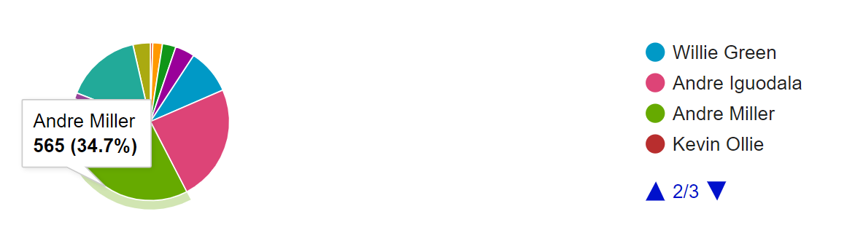
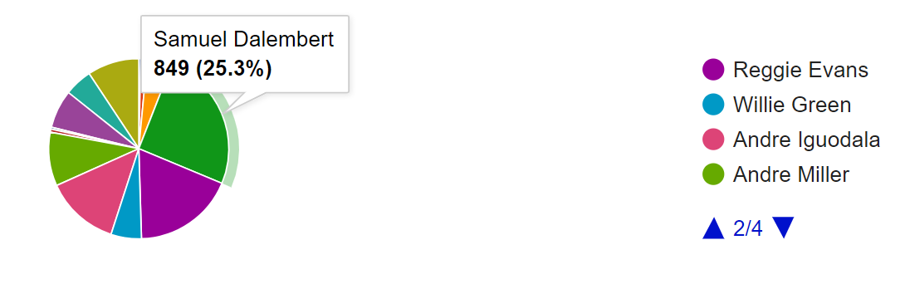
Pie Chart
Which player has most Assists
Which player has most Rebounds?

Slide 11
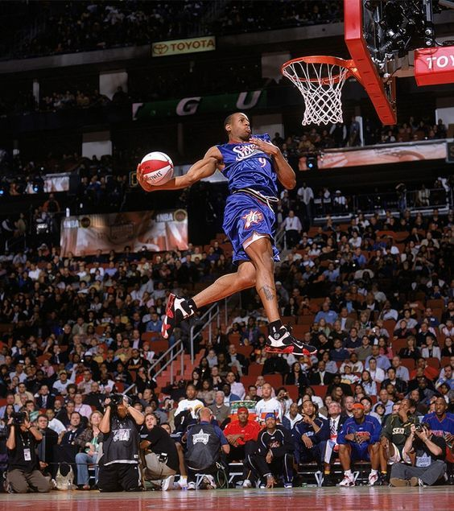
MVP In 76ers
In 76ers, Andre Iguodala obtains:
1st number of minutes played
1st number of Steals
1st PTG and FPG
2nd number of Rebounds
3rd number of Assists
For Team Most Valuable Player, he deserves the reward.

Slide 12
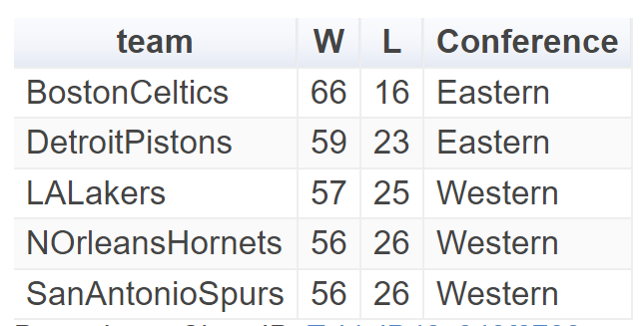
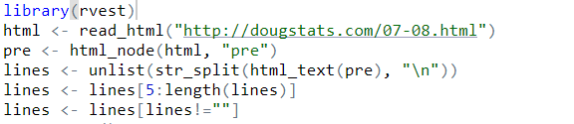
Table Chart
5 teams for the 2007-2008 season that have the most wins.

Slide 13
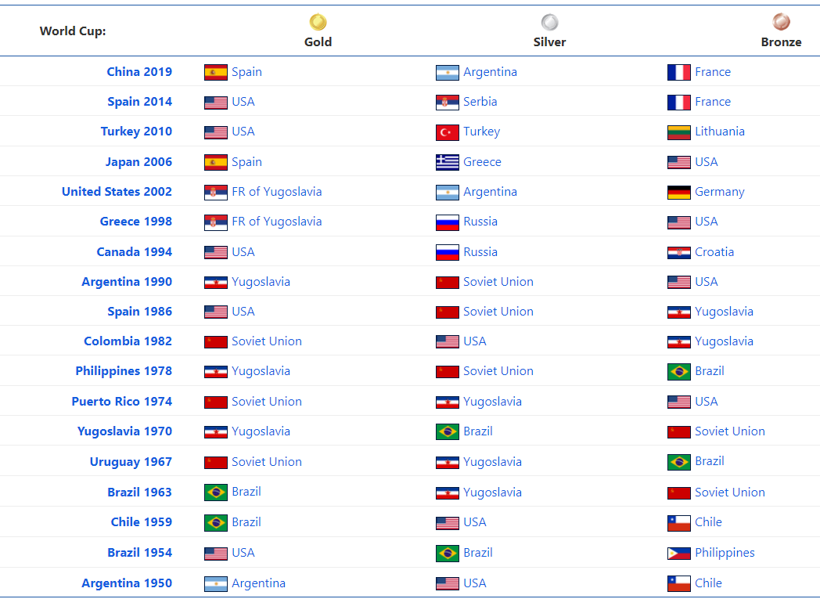
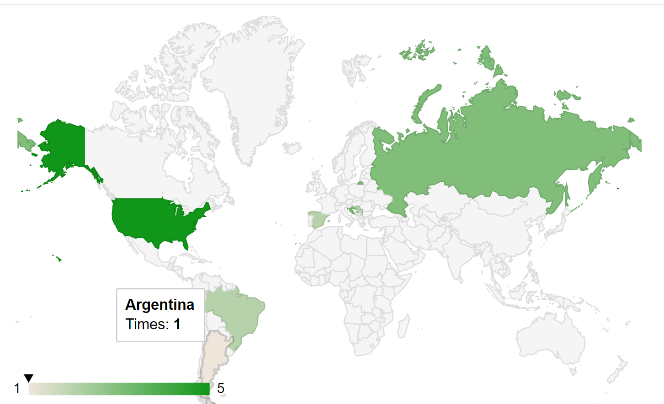
Geo Chart
Location on the world map all of the Basketball World Cup Champion countries.

Slide 14
Q&A
Thank You!

